Slide 1

Bachelor's Thesis presentation
A study on Topological Fermions
Presented by
Satabdee Subhadarshee Sahoo
15571 UG Physics 4th year

Slide 2
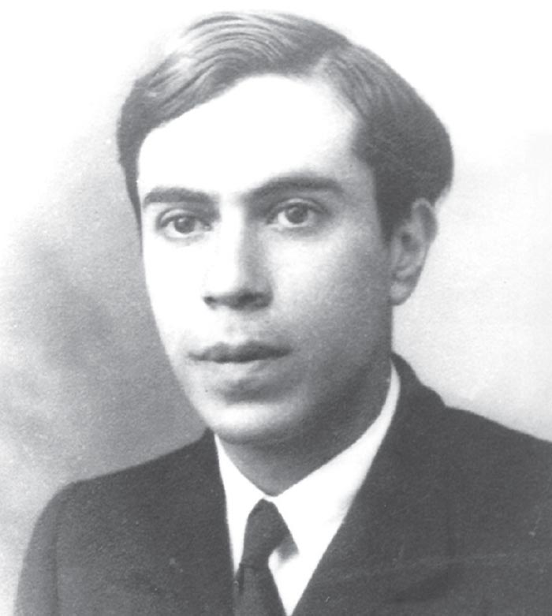
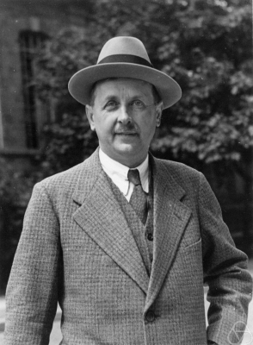
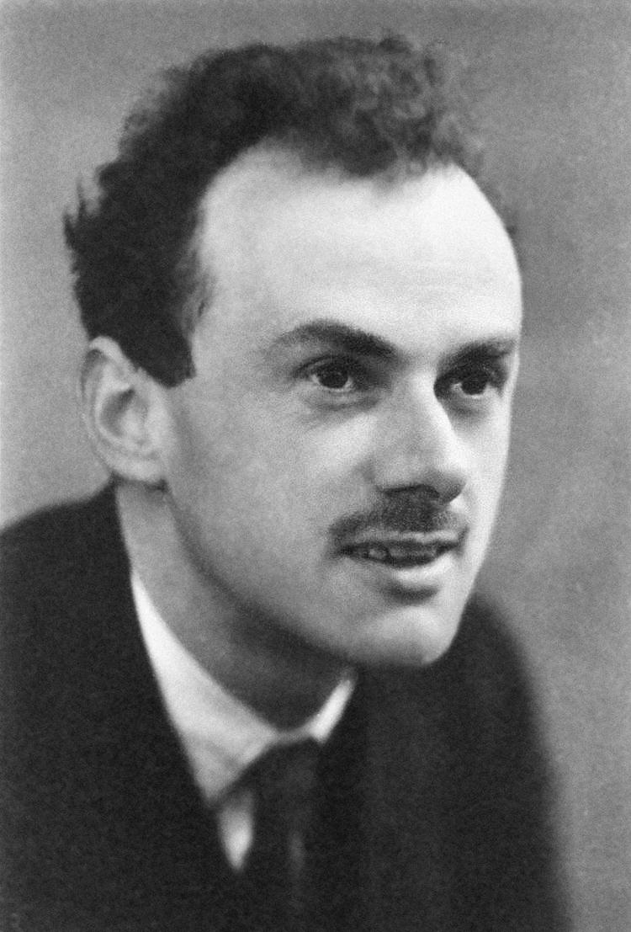
Topological fermions
Low energy excitations around gapless points protected by symmetries
Majorana
Conventional fermions
Unconventional fermions
(have counterpart in high energy physics)
(no counterpart in high energy physics)
Dirac
Majorana
Weyl
Weyl
Dirac

Slide 3
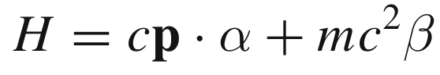
Conventional Fermions:
In 1928. Dirac proposed his relativistic form of Schrodinger equation, which led to the field of relativistic quantum mechanics. where H is a 4X4 hamiltonian
α and β are matrices constructed from the Pauli matrices. The eigen function 4 component spinor.
However, in later years Weyl and Majorana simplified the equation in their papers and thus predicted the presence of other quasiparticles.
Weyl in his 1929 paper simplified Dirac's equation by putting the mass term=0 which decoupled the Dirac's equation into 2 Weyl equation.
This led to prediction of weyl fermions but these were not observed in experiments until 2015 when TaAs crystal was found out to have these spin ½ excitations.

Slide 4
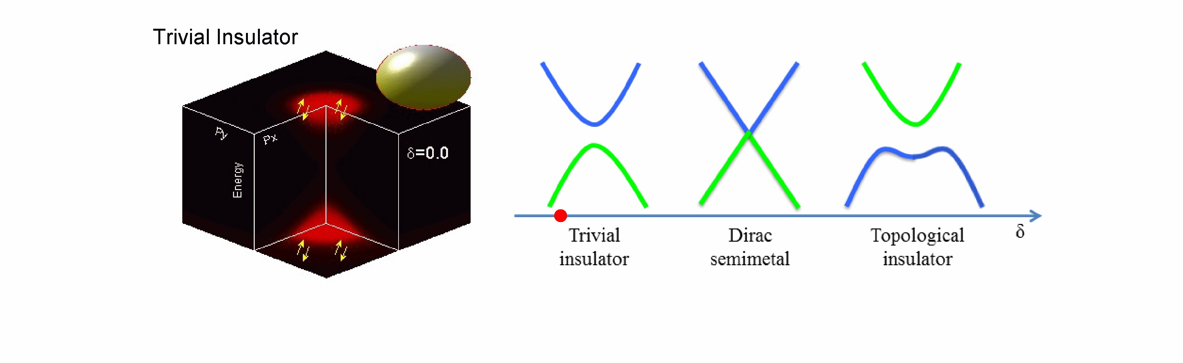
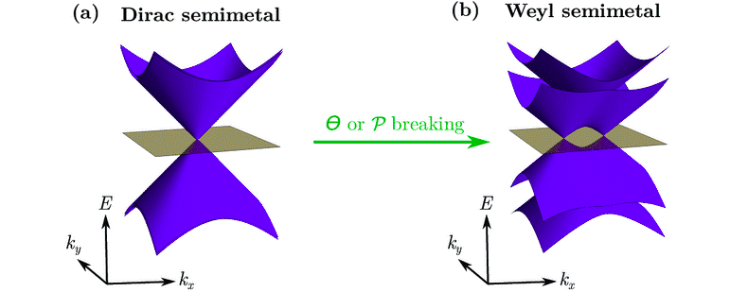
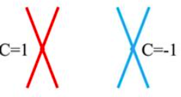
The interplay between the topological phases of matter
https://www.physics.princeton.edu/zahidhasangroup/index_TPT.html
Weyl semimetal bulk bands
Projected surface bands

Slide 5
Time Reversal Symmetry Breaking
Inversion Symmetry breaking
Wann et al. (2011)
Pyrochlore Iridates R₂Ir₂O₇
2012 Singh et al.
Experimental results not clear
Tunable TI :TlBi(S_{1-x}Se_{x})₂ TlBi(S_{1-x}Te_{x})₂ and altering b/w both layers
Burkov & Balents (2011)
heterostructres built from topo insulators and magnetic layers
Experimentally not realized
Halasz & Balents 2012
HgTe/CdTe heterostructure
Bulmash et al. 2014 Hg_{(1-x)}Cd_{x}Mn_{y}T
HgTe TI + Cd doping to reach band inversion state
Magnetic doping with Mn to break TRS
Elegant theories but experimentally not realized
Bad quality results because of Cd doping
2014 Liu & Vanderbilt
Discovery of Na₃Bi and Cd₃As₂ DSM 2014
LaBi_{1−x}Sb_{x}Te₃ and LuBi_{1−x}Sb_{x}Te₃ heterostructure
Same approach as Bulmash but no need for doping as they already are DSM;
Not much work has been done.

Slide 6
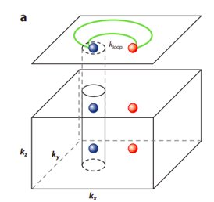
Conventional Weyl Fermions in TaAs:
Although predicted earlier, experimentally first observed in TaAs. Total of 24 Weyl points present in the bulk. Projected surface show fermi arcs.
The Weyl points are closely located in the bulk and are not necessarily present at high-symmetry points.
Significantly small fermi arcs which are difficult to observe. Has topological charge of ±1.
Has small topological non-trivial energy window.
Shin-Ming Huang et al. 7373 (2015)

Slide 7
Unconventional Fermions:
What is Unconventional Fermion?
Where can we find them?
Why are these systems interesting?

Slide 8
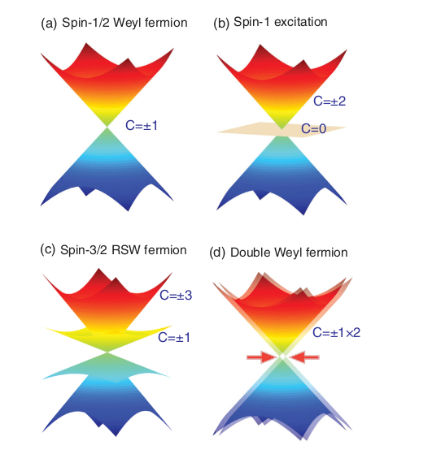
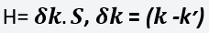
1) What are Unconventional Fermions?
Protected by crystal symmetries(usually non- symmorphic symmetries)
No high energy counterparts
Degeneracy more than 2.
Can be described by denotes the momentum deviation from crossing point k' and S is the matrices for pseudospin DOF
2)Where can we find them?
Theoretical prediction:
SG 198,199,205,206,212,213,214 etc.
Experimentally verified systems: AlPt , PtGa, PdGa, CoSi, RhSi etc.
Bradlyn et al. science.aaf5037(2016)
Tang et al. Phys. Rev. Lett. 119.20 (Nov. 17, 2017)
Notes:
Rarita-Schwinger-Weyl

Slide 9
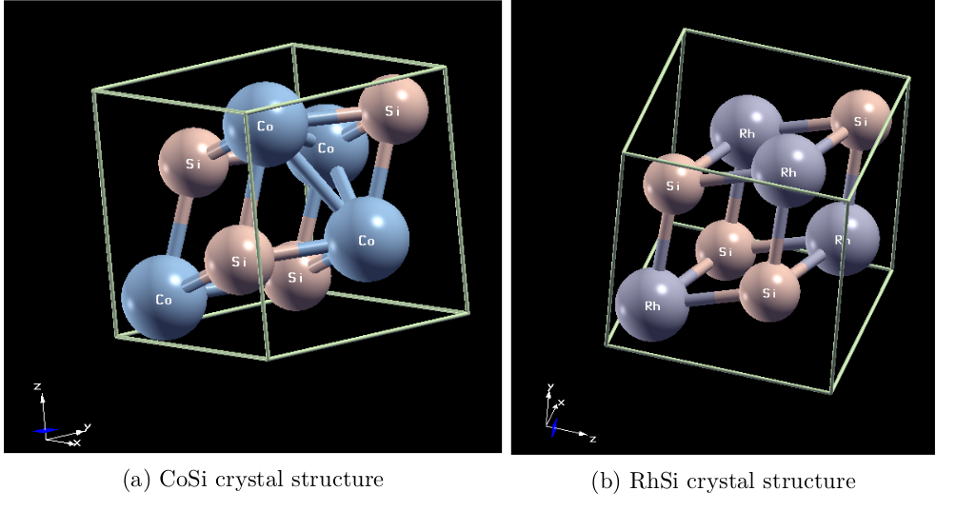
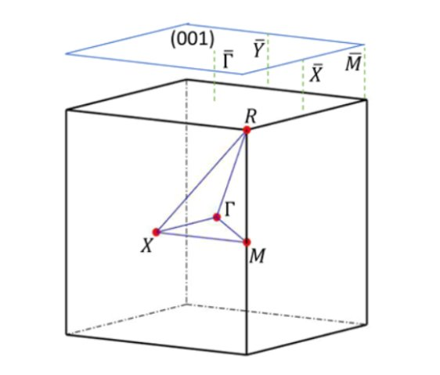
Our System: Transition Metal Silicides
Brillouin zone

Slide 10



METHODOLOGY:
DFT calculations are done using Quantum Espresso¹.
GGA-PBE exchange-correlation functionals are used².
Ultrasoft pseudopotentials are used³.
K-mesh 9X9X9
Energy cutoff: 60 Rydberg
Wannierization of the bands ,i.e., creating a tight binding hamiltonian, was done with Wannier90⁴
Topological characterization , surface states and fermi arcs are calculated using WannierTools⁵
1 Paolo Giannozzi et al. 2009
2 John P. Perdew et al. Phys. Rev. Lett. 78, 1396 1997
3 David Vanderbilt Phys. Rev. B 41, 7892(R) 1990
4 AA Mostofi et al. Comput. Phys. Commun. 185, 2309 (2014)
5 Quan Sheng Wu et al. 2018

Slide 11
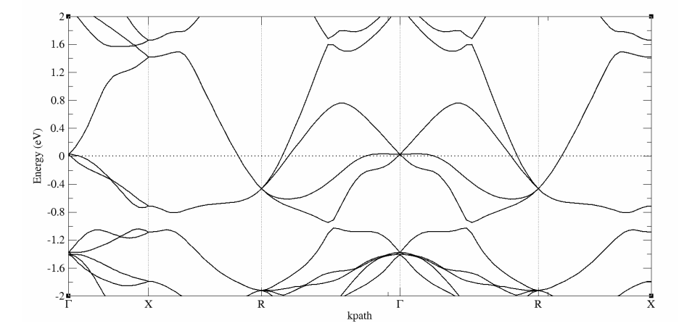
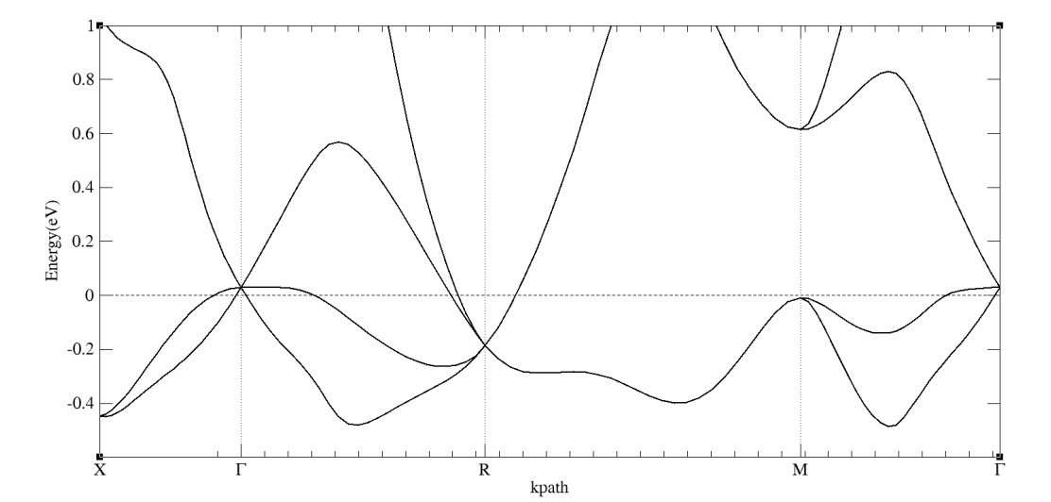
Band Structures without SOC:
RhSi
CoSi

Slide 12
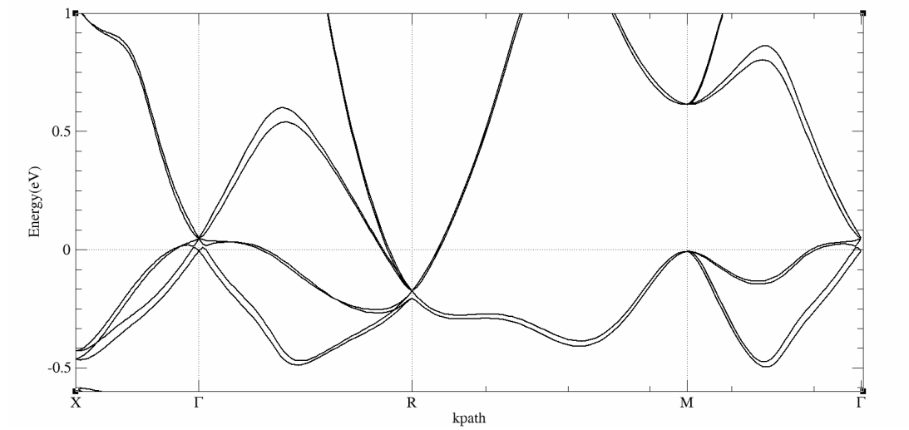
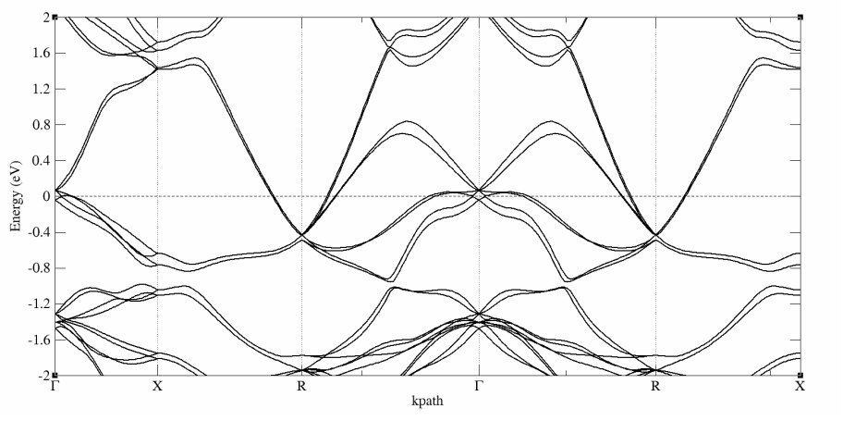
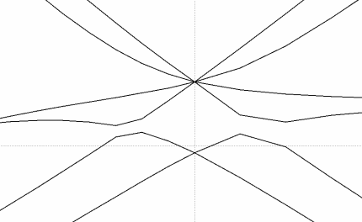
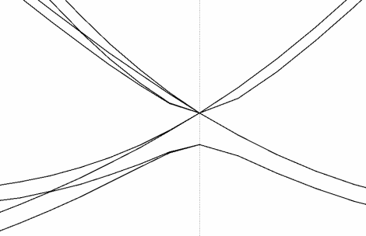
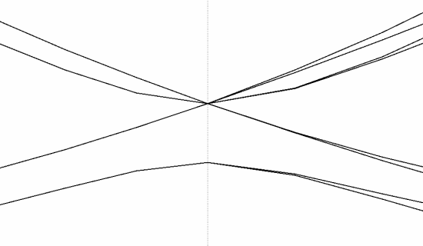
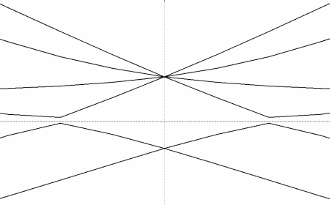
Band Structures with SOC
CoSi
RhSi
4-fold spin 3/2 RSW + Weyl Fermion
6-fold double spin-1 excitations
6-fold double spin-1 excitations
4-fold spin 3/2 RSW + Weyl Fermion

Slide 13
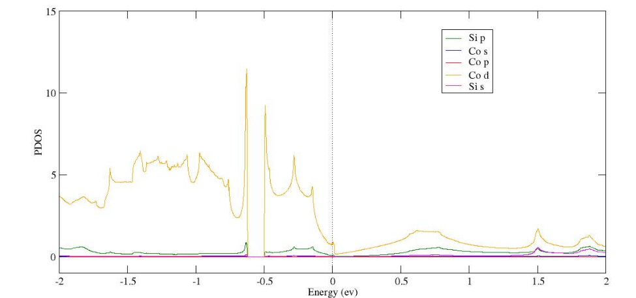
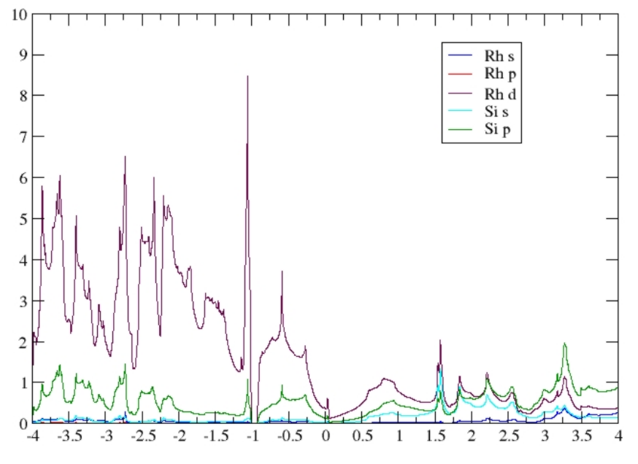
Partial Density of States:
CoSi
RhSi
Near Fermi level: Co/Rh d orbital and Si p orbital contribute the most

Slide 14
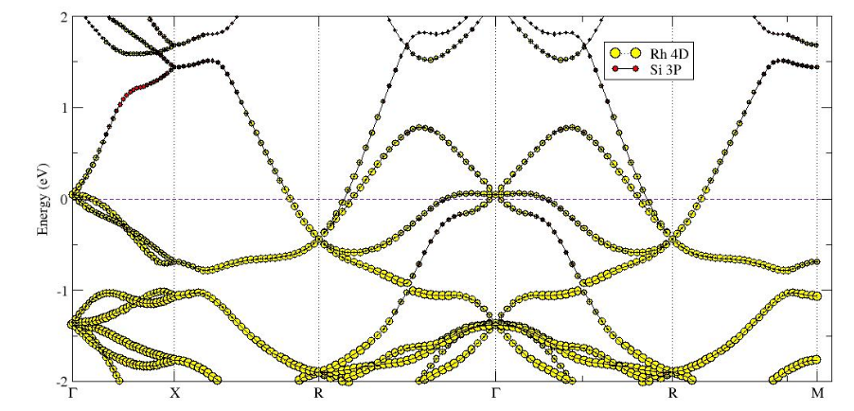
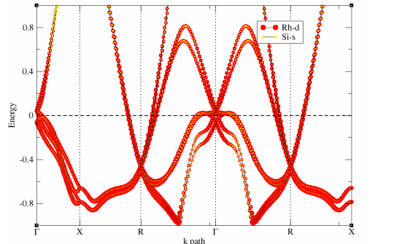
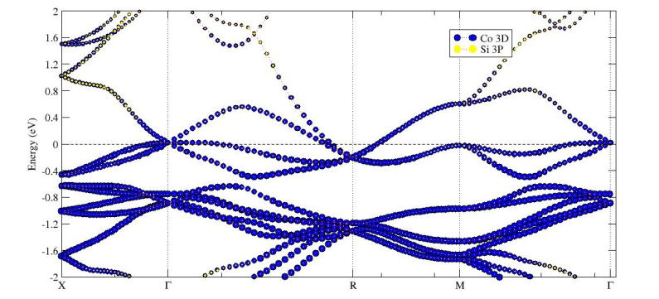
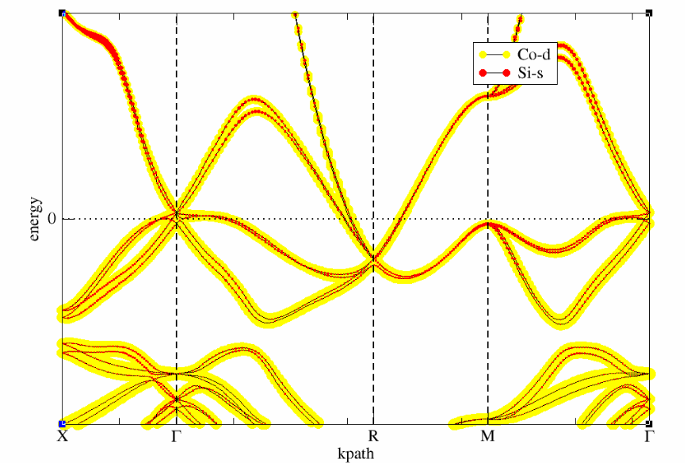
Projected Density of States/ Fat-bands
RhSi without SOC
RhSi with SOC
CoSi without SOC
CoSi with SOC

Slide 15
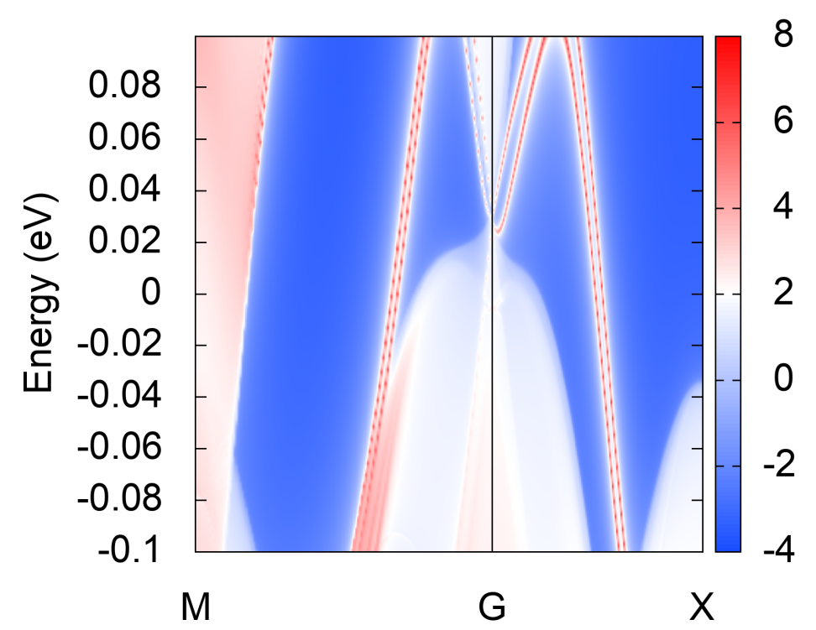
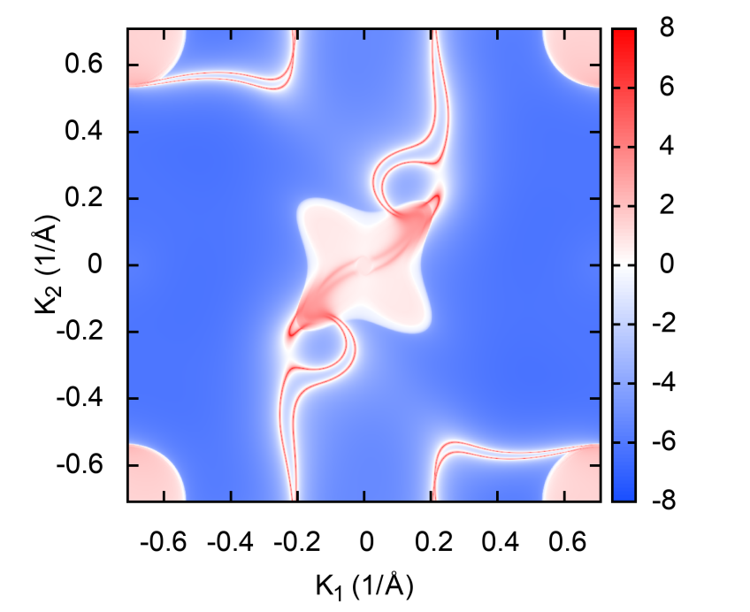
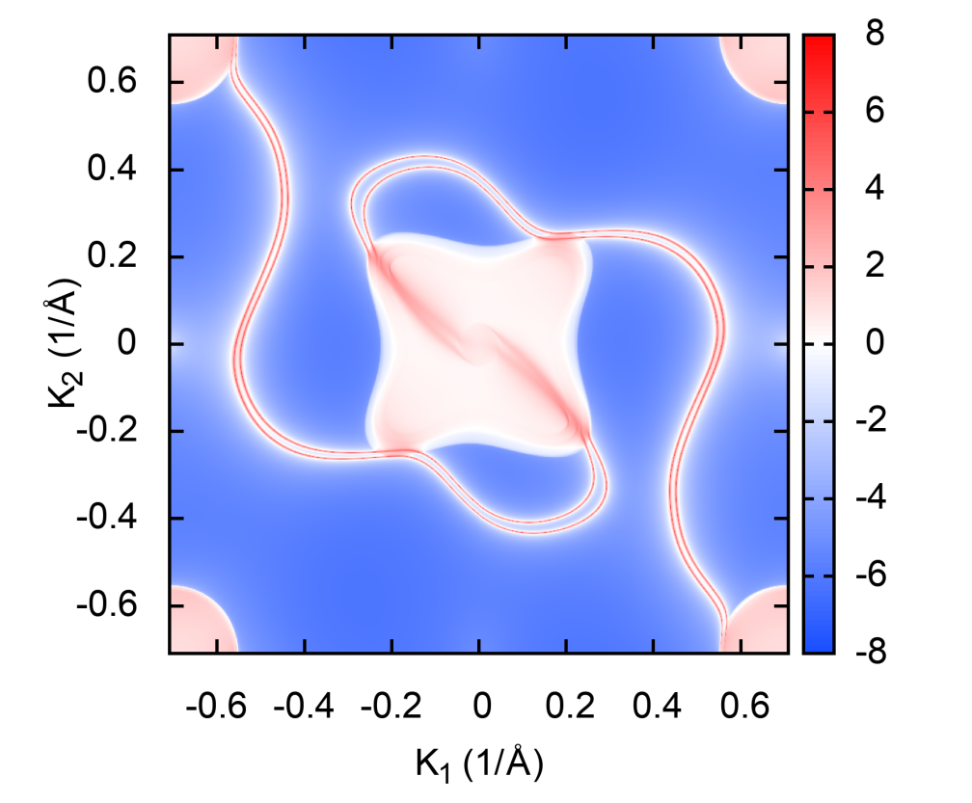
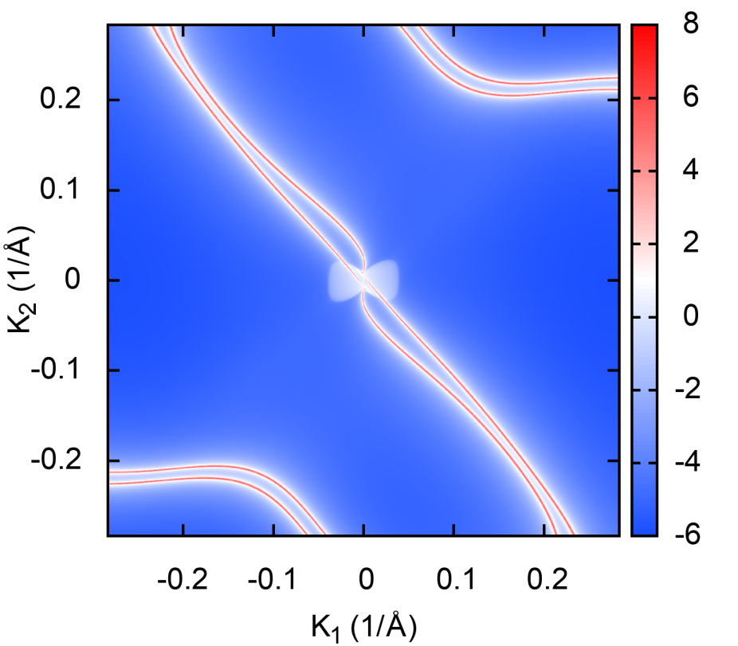
Surface States and Fermi arcs (CoSi-with SOC):
Surface States
Fermi surface= 0.00eV
Fermi surface= 0.025eV
Fermi surface= -0.025eV

Slide 16
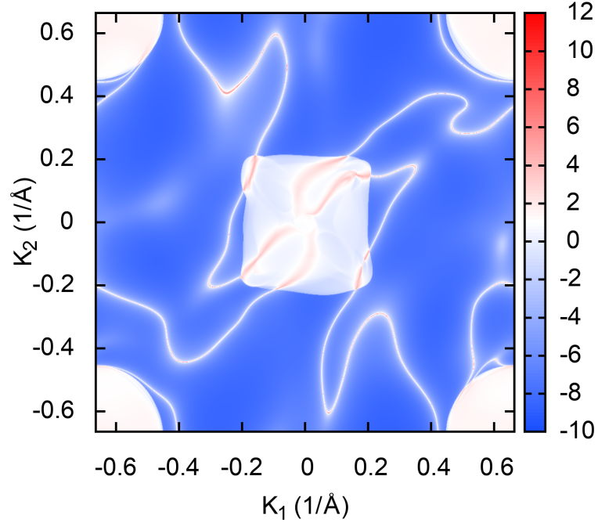
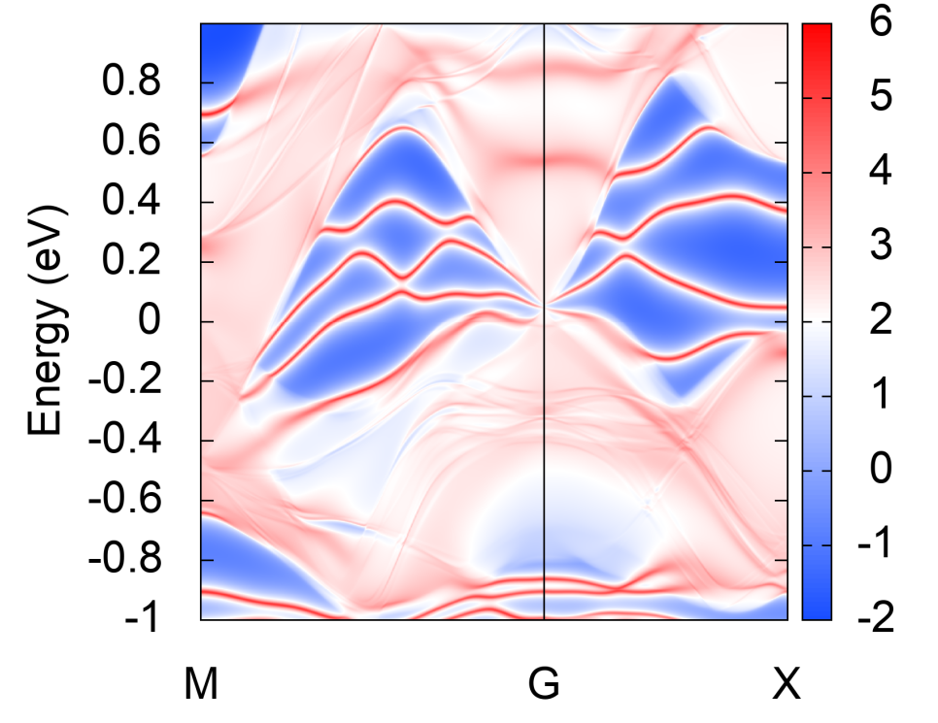
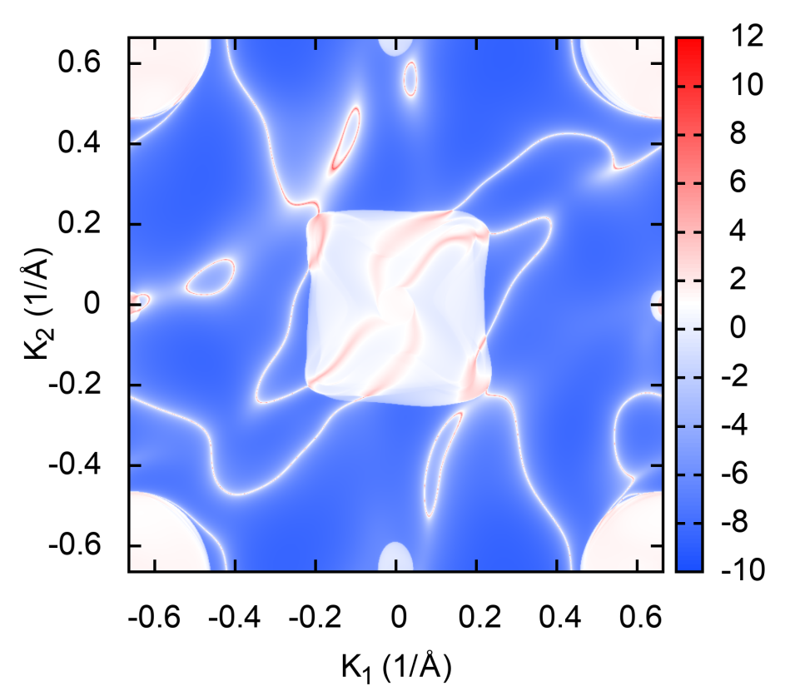
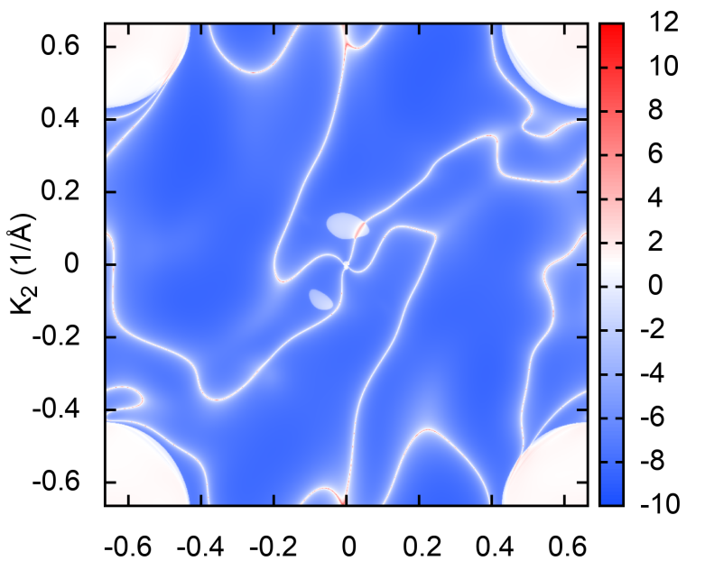
Surface States and Fermi arcs(RhSi-with SOC):
Surface States
Fermi surface= 0.005eV
Fermi surface= +0.0255eV
Fermi surface= -0.0255eV

Slide 17
Why are these systems interesting?
These systems(RhSi and CoSi) are of great interest because :
They have large Fermi arcs(experimental visualization is easier)
The fermi arcs are disjoint unlike TaAs.
The arcs are topologically protected against perturbations.
Have large topologically non-trivial energy window.
The number of Weyl points in the bulk is the least(2) and the largest chiral charge ever measured in a bulk material(4)
Can be helpful in probing the quantized photogalvanic effect and understanding light matter interactions

Slide 18
Future directions:
Effect of Impurities on Transition metal silicides:
Symmetries might be protected.
Multifold fermions might not be there. Some degeneracy will be lifted.
There may be a possibility of having a topological phase transition from semimetal to different phases.

Slide 19
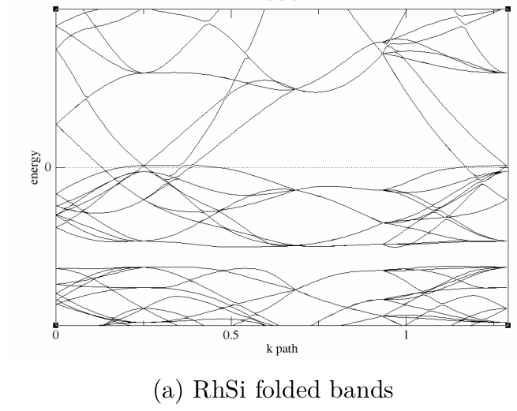
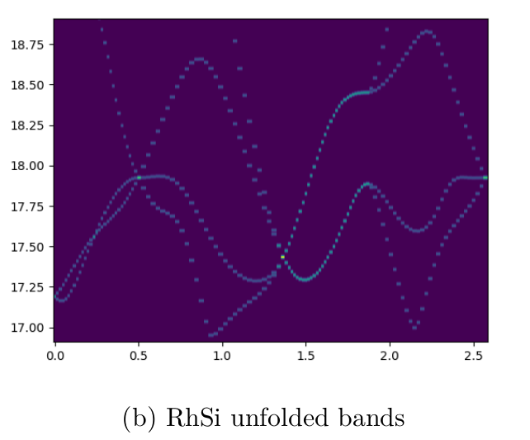
Unfolding of folded bands for supercell:
2x2x2 supercell
https://journals.aps.org/prb/abstract/10.1103/PhysRevB.85.085201

Slide 20
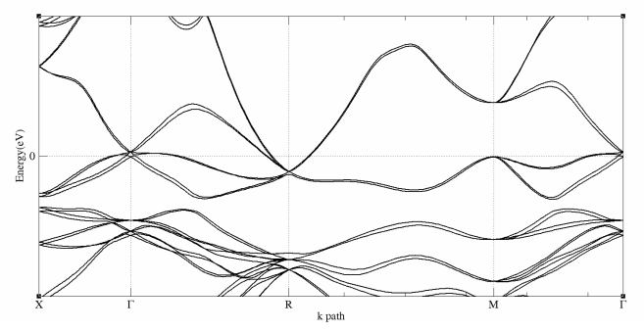
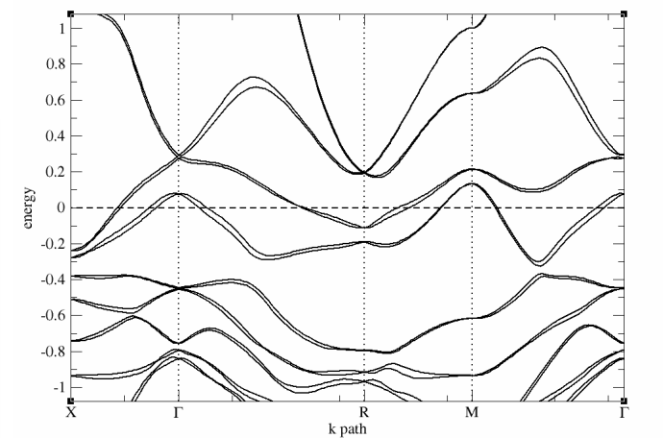
Bulk Band structure with and w/o impurities:
CoSi without impurity
CoSi with 1 Fe impurity

Slide 21
The end

Slide 22
Relevant Papers:
Photogalvanic effect in quantum wells: https://www.sciencedirect.com/science/article/pii/S1386947702003715
Strain-induced topological charge control in multifold fermion systems https://iopscience.iop.org/article/10.1088/1361-648X/ac0fa0
Dirac Fermions in Solids: https://www.annualreviews.org/doi/10.1146/annurev-conmatphys-031113-133841
Topological Materials: Weyl Semimetals : https://www.annualreviews.org/doi/10.1146/annurev-conmatphys-031113-133841

Slide 23
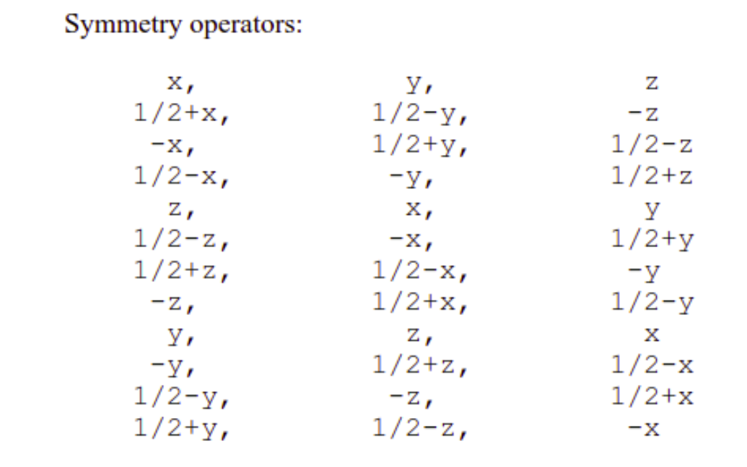

Slide 24
Calculations Done:
Band structures with and w/o SOC
Partial Density of States
Projected DOS
Wannierization
Surface states
Fermi Arcs

Slide 25
The Basic Problem:
We can get WSM from DSM if we break either Time Reversal Symmetry(TRS) or Inversion Symmetry(IS).
But nature prefers to preserve both TRS and IS in systems. So suitable candidate for WSM are difficult to find which clearly explains the late discovery of these WSM although they were predicted way back.
Even with advanced computational techniques which could simulate and predict these phases and experimental verification techniques like ARPES the discovery of WSM was delayed because of lack of candidates

Slide 26
Brief intro of the WSM:
Dirac points in graphene, topological insulators , and Dirac semimetals typically require not only the symmetries implied within band theory but further rely on time-reversal symmetry, inversion symmetry, or other crystal space group symmetries.
However Weyl points are uniquely robust in that they are topologically stable within band theory without any additional symmetries.
They show a variety of exotic properties like fermi arcs, chiral anomaly, magneto-transport etc.
BUT WHAT MATERIALS SHOW THESE PROPERTIES and how do we choose them/synthesize them: the search for answer to this question led to many proposals before the 1st WSM TaAs was discovered

Slide 27
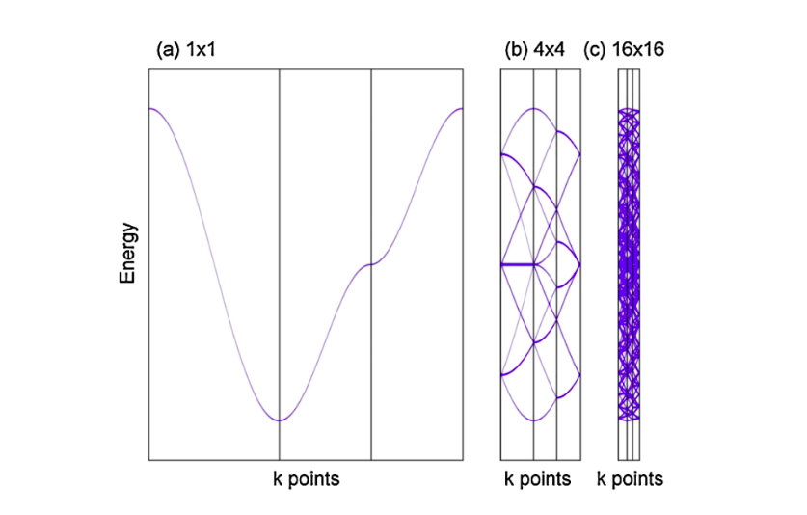
SUPERCELL CALCULATIONS:
Cite 2012 pou.. Paper

Slide 28
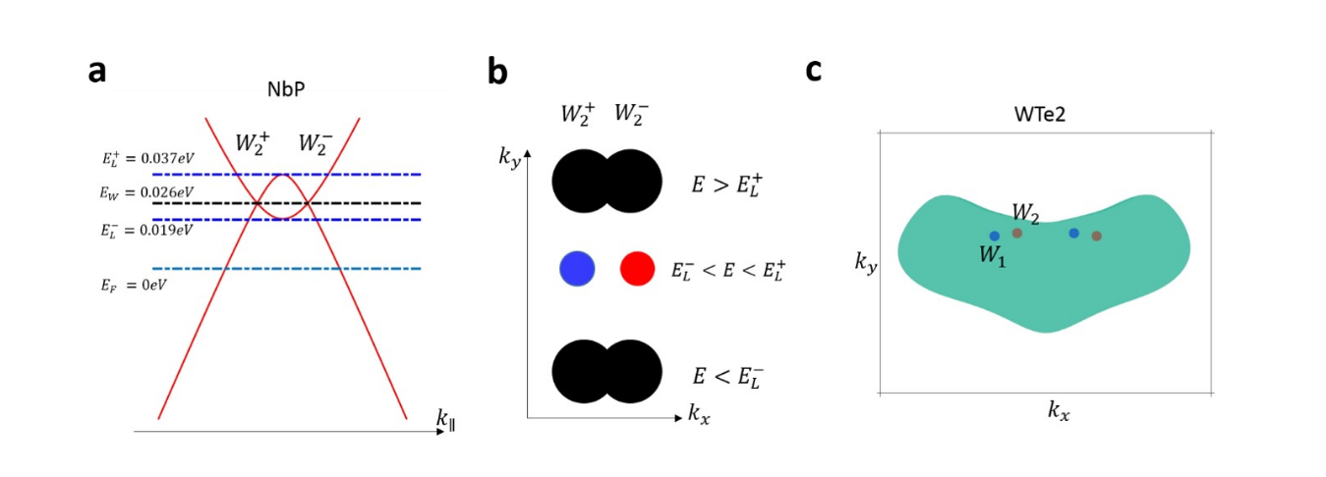

Slide 29
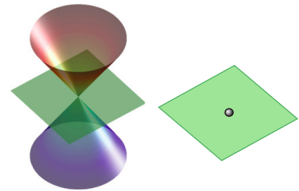
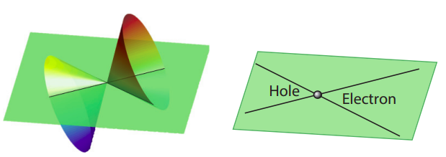
The Weyl Semimetal:
The physics of Weyl Semimetal(WSM) can be described by massless Weyl fermions.
We shall concern ourselves with type-1 WSM only.
WSM
Type-I
Type-II

